Slide 1
Python programming
unit 4c – generator

Slide 2
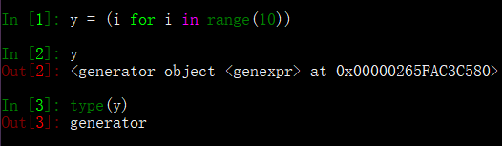

Simple generator
Using simple for loop can define a generator.
Can use ‘*’ operator with generator, to do list comprehension, produce a list.

Slide 3

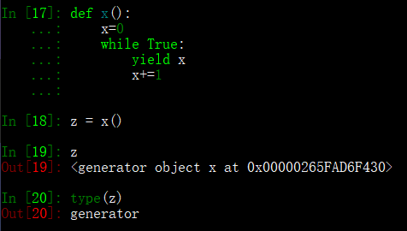
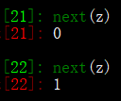
Use function to make generator
Define a function, which don’t have return but with yield
Call to this function will produce a generator
next() on generator will give the value one by one.

Slide 4
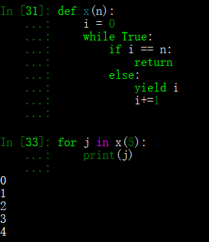
Add Stop condition for function created generator
Add return. When this return executed, the generator will stop.

Slide 5
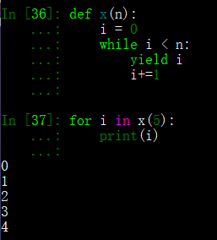
Non explicit return is same effect
It is same like last function produced generator.

Slide 6
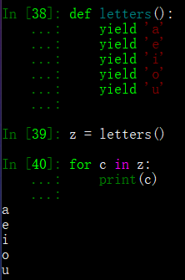
As simple as several yield also can do
Each time give one value by one yield.
After all yield done the function implicitly return. So the generator stops.

